Slide 1
Legal structures, registration & taxation: starting a business venture poses the challenge of selecting a business structure, which will have both legal and tax implications, a monumental step to formation of a new business, understanding the implications, advantages, and disadvantages of each legal status.

Slide 2

How to start business??
This Photo by Unknown Author is licensed under CC BY-SA-NC

Slide 3
Legal structures of business
Proprietor Company
Private Limited Company
Public Company
Non-Profit Company
Foreign Company

Slide 4
Proprietor Company
Sole
Partner

Slide 5
Private Limited Company
(Registered at Office of Company Registrar-OCR)
Sole (Psn
Partnership (ax'n)

Slide 6
Determine the Capital
Fix the number of shareholders
Finalize the share ratio

Slide 7
prepare the partnership agreement
Memorandum of Association (MOA)
Articles of Association (AOA)

Slide 8
step to registering a private limited company in Nepal.
Step 1: Choose and reserve a unique name for your company
Step 2: Prepare the necessary documents

Slide 9
the necessary documents
Information Required
Proposed name for your company
Proposed registered address of your company
Major objectives of your company
Authorized Capital
Issued & Paid Up Capital
BoD Members and their tenure
Number of Promoters and details of the Promoters along with current address
Subscribed number of shares by each Promoter
Documents Required
Citizenship copies of Promoters (Notarized)
Consensus Agreement between Promoters, if any.
Personal PAN of Promoters
Copy of citizenship of Lessor/Landlord where the registered address of Company shall be located.
A copy of the utility bill of the household or land registration certificate of the proposed location.

Slide 10
Step 3: Register the company
Once you have prepared the necessary documents and your company name is approved, you can file the application for company registration online with the OCR. The application should include an application, the MoA and AoA, notarized copies of the promoter's citizenship certificate, and the application fee.

Slide 11
१. कम्पनी संस्थापनाको प्रयोजनको लागि: क) प्राईभेट लिमिटेड कम्पनी
१. रु १,००,०००/- सम्मको अधिकृत पूँजी भएको
रु. १,०००/-
२. रु. १,००,००१/- देखि रु ५,००,००० /- अधिकृत पूँजी भएको
रु. ४,५००/-
३. रु. ५,००,००१/- देखि रु २५,००,००० /- अधिकृत पूँजी भएको
रु. ९,५००/-
४. रु. २५,००,००१/- देखि रु १,००,००,००० /- अधिकृत पूँजी भएको
रु. १६,०००/-

Slide 12
५. रु. १,००,००,००१/- देखि रु २,००,००,००० /- अधिकृत पूँजी भएको
रु. १९,०००/-
६. रु. २,००,००,००१/- देखि रु ३,००,००,००० /- अधिकृत पूँजी भएको
रु. २२,०००/-
७. रु. ३,००,००,००१/- देखि रु ४,००,००,००० /- अधिकृत पूँजी भएको
रु. २५,०००/-
८. रु. ४,००,००,००१/- देखि रु ५,००,००,००० /- अधिकृत पूँजी भएको
रु. २८,०००/-
९. रु. ५,००,००,००१/- देखि रु ६,००,००,००० /- अधिकृत पूँजी भएको
रु. ३१,०००/-
१०. रु. ६,००,००,००१/- देखि रु ७,००,००,००० /- अधिकृत पूँजी भएको
रु. ३४,०००/-

Slide 13
११. रु. ७,००,००,००१/- देखि रु ८,००,००,००० /- अधिकृत पूँजी भएको
रु. ३७,०००/-
१२. रु. ८,००,००,००१/- देखि रु ९,००,००,००० /- अधिकृत पूँजी भएको
रु. ४०,०००/-
१३. रु. ९,००,००,००१/- देखि रु १०,००,००,००० /- अधिकृत पूँजी भएको
रु. ४३,०००/-
१४. रु. १०,००,००,०००/- भन्दा माथि प्रति १ लाखको
रु ३०/- का दरले दस्तुर लाग्ने छ ।

Slide 14
Step 4: Execute lease agreement for registered office and register at ward office
Once the company is registered, the company can now officially enter into a lease agreement for its registered office location. Even if it is the promoter’s office, the company will have to enter into a lease agreement (Remember once the company is registered, it is a separate legal person now and distinct from the promoter(s)).

Slide 15
Step 5: Obtain a tax registration certificate
The next step then is to obtain a tax registration certificate, generally referred to as Permanent Account Number or PAN, from the Inland Revenue Office or the Taxpayers Service Office, as the case may be. We will refer to these as Tax Office for our ease. The application has to be filed online using the credentials and details provided by the OCR in the PAN Reservation Letter at the time of company incorporation.

Slide 16
Step 6: Open a bank account
Once you have obtained the tax registration certificate, you can open a bank account in the name of the company. This will allow the company to receive the committed investment from the promoters and also receive payments from clients and customers.

Slide 17
Step 7: Obtain other licenses and permits
Depending on the nature of your business, you may need to obtain other licenses and permits from the relevant government agencies.
At the same time, it is mandatory for your company to obtain either an industry registration or registration at the Department of Commerce depending on the nature of your company’s business.

Slide 18
Public Limited Company (Registered at Office of Company Registrar-OCR)
Minimum 7 shareholders
From the conversion of private limited company

Slide 19
ख) पव्लिक लिमिटेड कम्पनी
१. रु १,००,००,००० /- अधिकृत पूँजी भएको
रु. १५,०००/-
२. रु १,००,००,००१ /- देखि रु १०,००,००,००० /- अधिकृत पूँजी भएको
रु. ४०,०००/-
३. रु १०,००,००,००१ /- देखि रु २०,००,००,००० /- अधिकृत पूँजी भएको
रु. ७०,०००/-
४. रु २०,००,००,००१ /- देखि रु ३०,००,००,००० /- अधिकृत पूँजी भएको
रु. १००,०००/-

Slide 20
५. रु ३०,००,००,००१ /- देखि रु ४०,००,००,००० /- अधिकृत पूँजी भएको
रु. १३०,०००/-
६. रु ४०,००,००,००१ /- देखि रु ५०,००,००,००० /- अधिकृत पूँजी भएको
रु. १६०,०००/-
७. रु. ५०,००,००,०००/- भन्दा माथिको अधिकृत पूँजी भएमा प्रति १ करोडको
रु.३०००/- का दरले दस्तुर लाग्नेछ ।

Slide 21
ग) दर्ता भैसकेको कम्पनीले पूँजी वृद्धि गरेमा : पछिल्लो पूँजी कायम भएको थप पूँजी अनुरुप पहिले तिरीसकेको दस्तुर कट्टा गरी नपुग रकम नयाँ दररेट अनुसार वुझाउनुपर्नेछ ।

Slide 22
Non-Profit Company
NGO/ INGO
Profit not distributing company

Slide 23
Company/ organization
No. of members
Tax Clearance
Social Welfare Council
Sustainability
Legal Compliances
Revenue
governance

Slide 24
Foreign Company (Registered at Office of Company Registrar-OCR
Foreign Direct Investment
Joint Venture

Slide 25


Slide 26
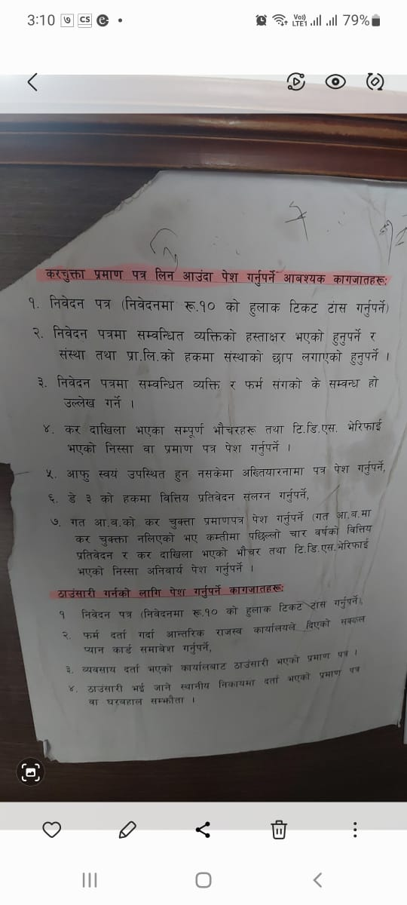

Slide 27
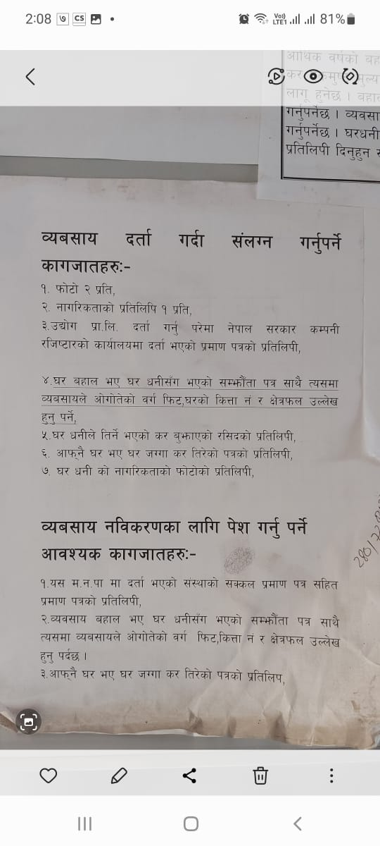

Slide 28
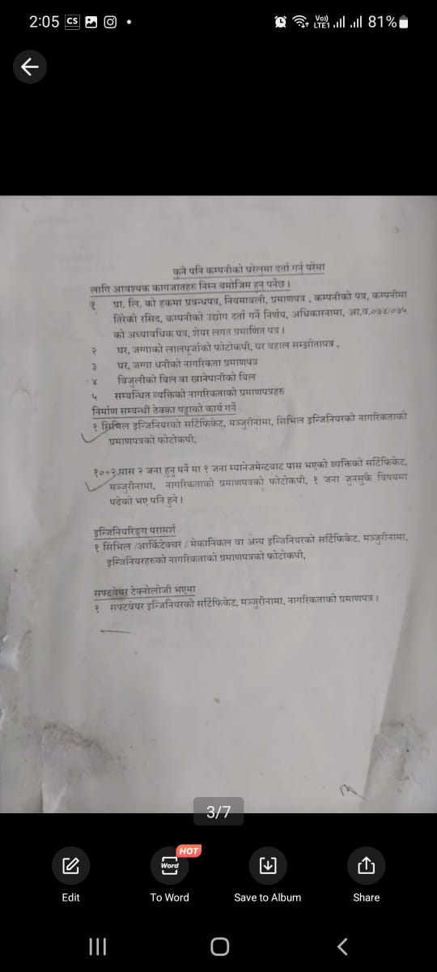

Slide 29
